Slide 1
Hotel Booking Analysis
Gaser zaghloul

Slide 2
Introduction
Overview: Analysis of hotel booking data to understand guest behavior, booking trends, pricing, and cancellation patterns.
Objective: Provide insights into factors affecting bookings and cancellations to optimize hotel operations

Slide 3
EDA Process
Data Loading and Cleaning
Libraries used (e.g., Pandas, Matplotlib, Seaborn)
Data types, missing values, and duplicates
Descriptive Analysis
Summary statistics of numerical columns
Range of week & weekend nights
Min and max number of adults and children
Visualizations and Insights
Distribution and correlation of numerical data
Booking trends by day of the week and month
Pricing analysis across room and meal types

Slide 4
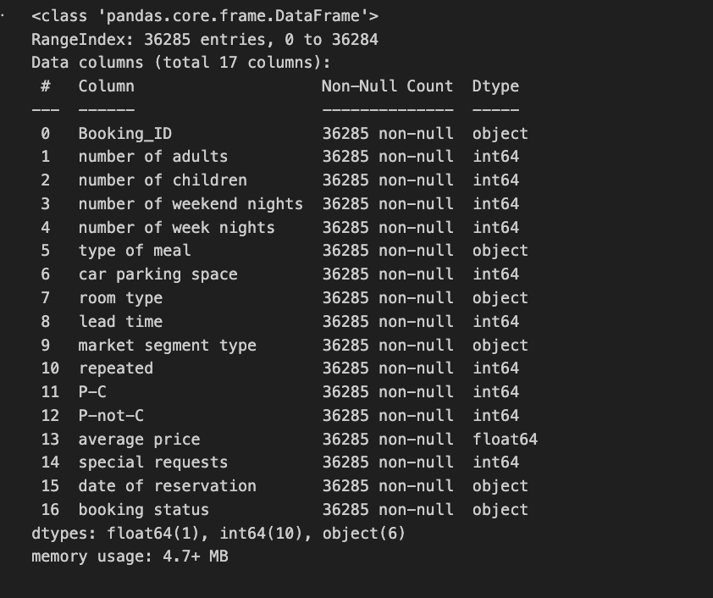
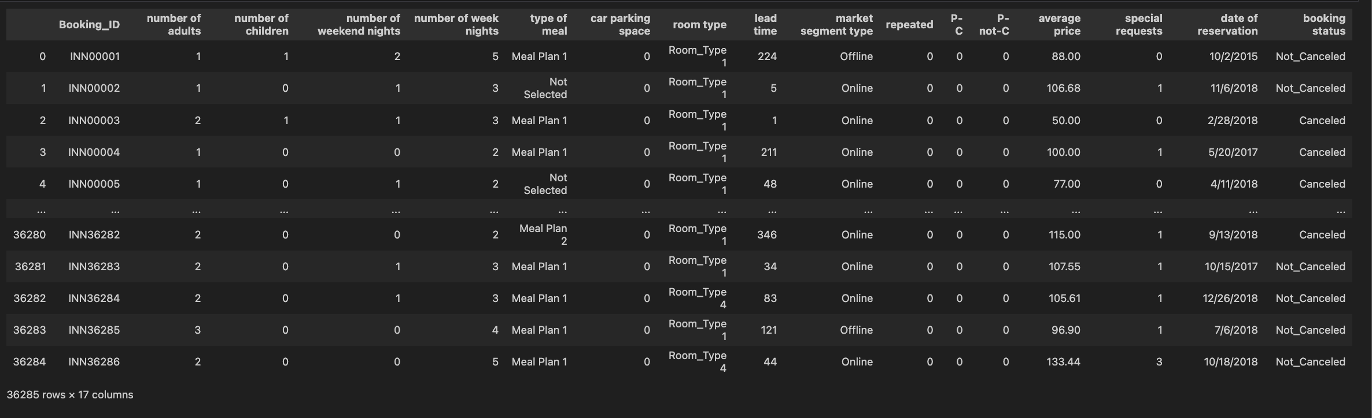
Read data & check data types

Slide 5
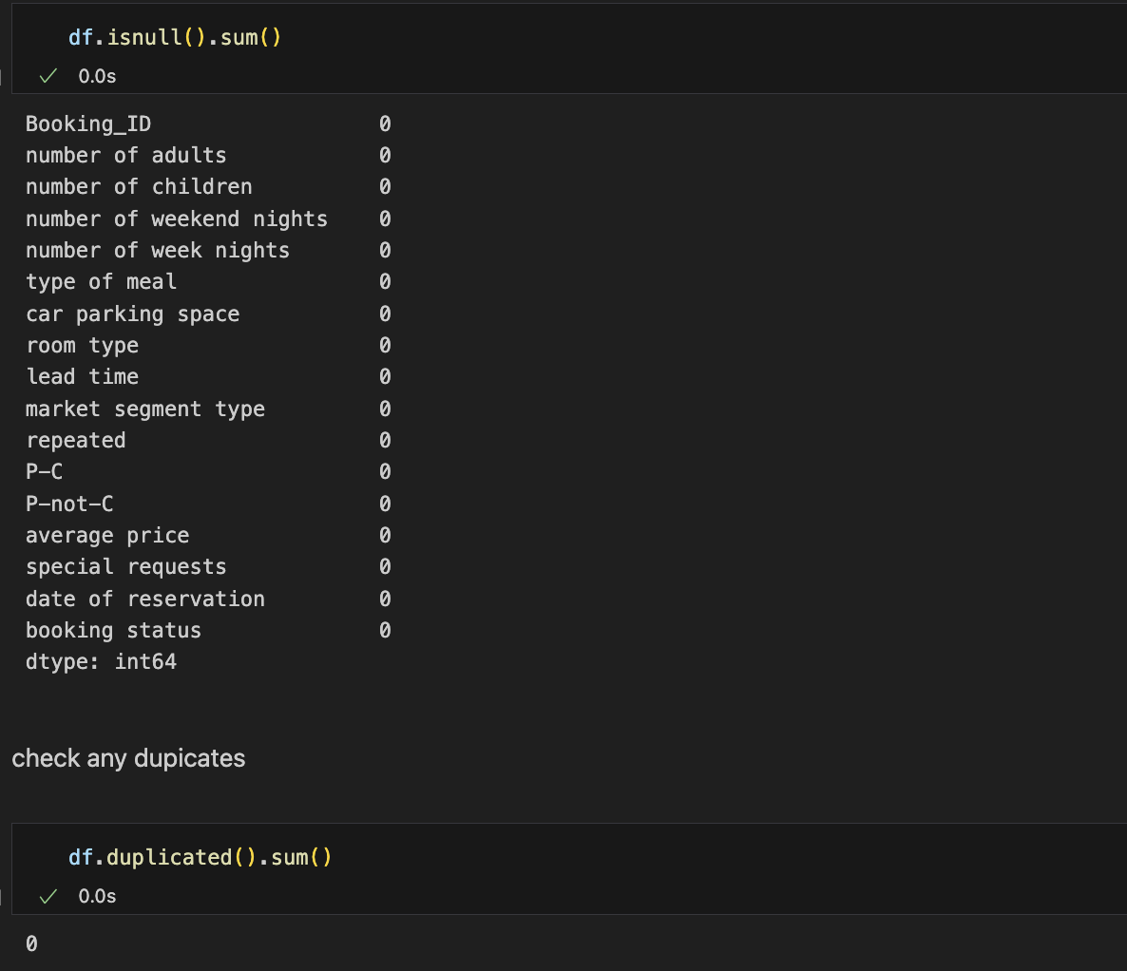
Missing values & Duplicates

Slide 6
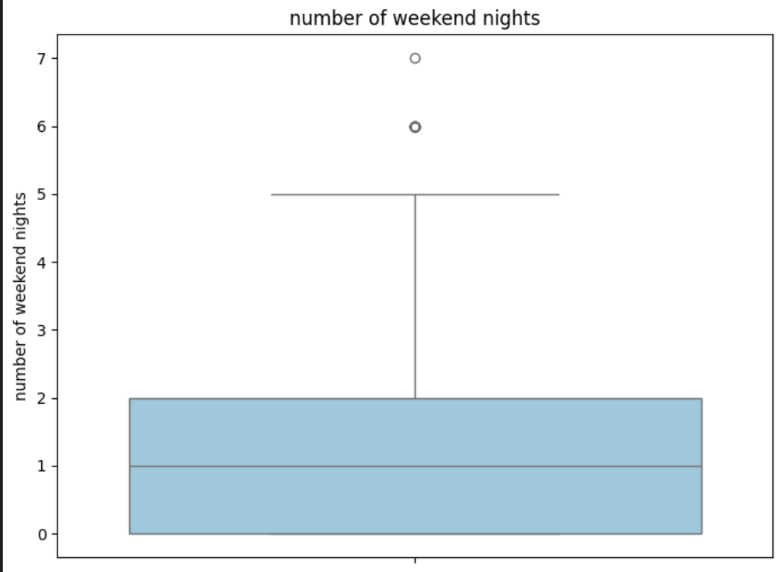
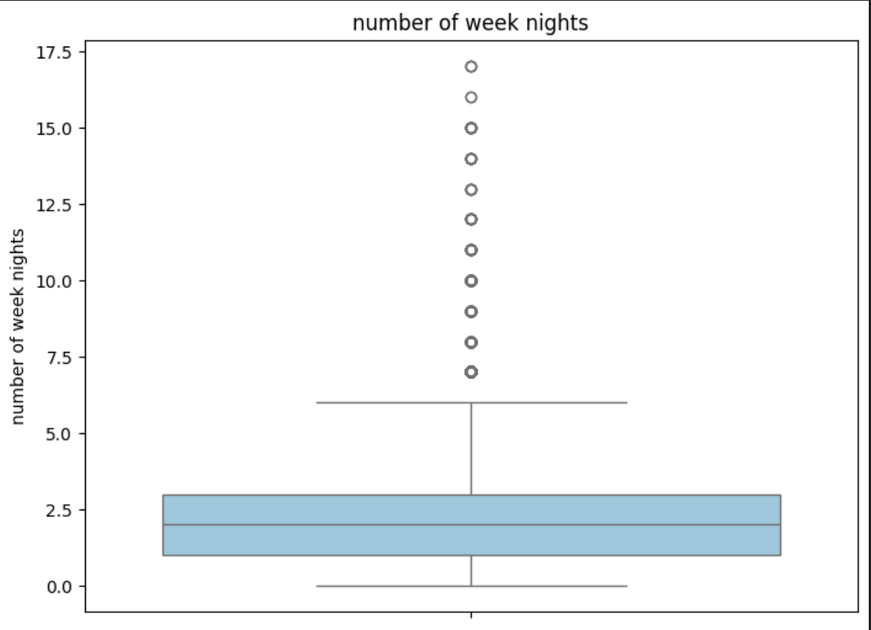
Week & Weekend Nights Range

Slide 7
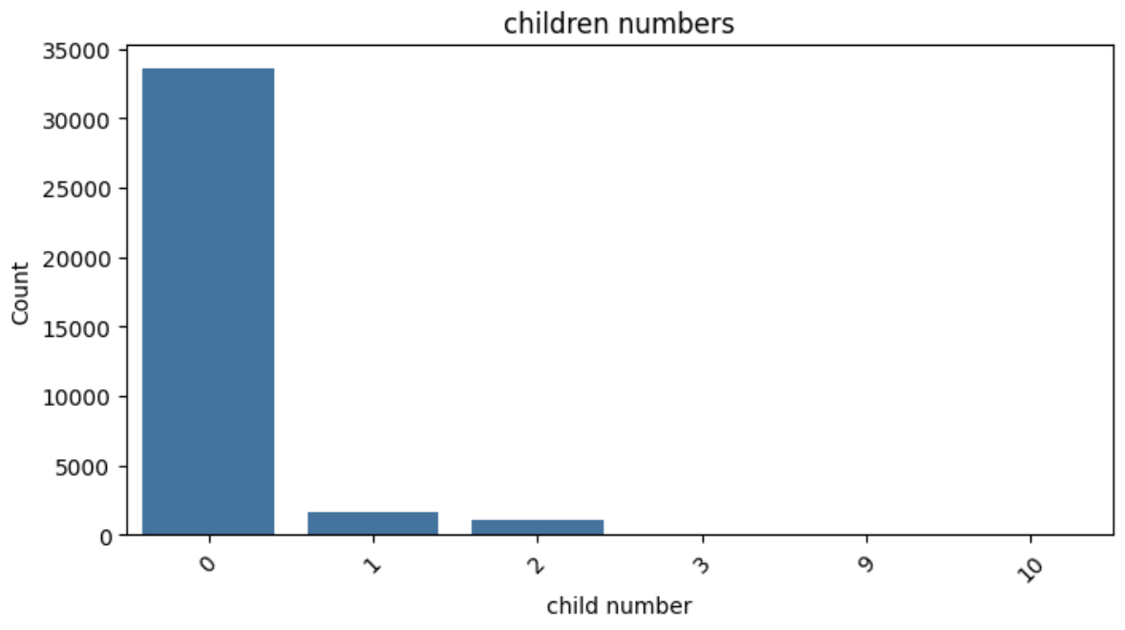
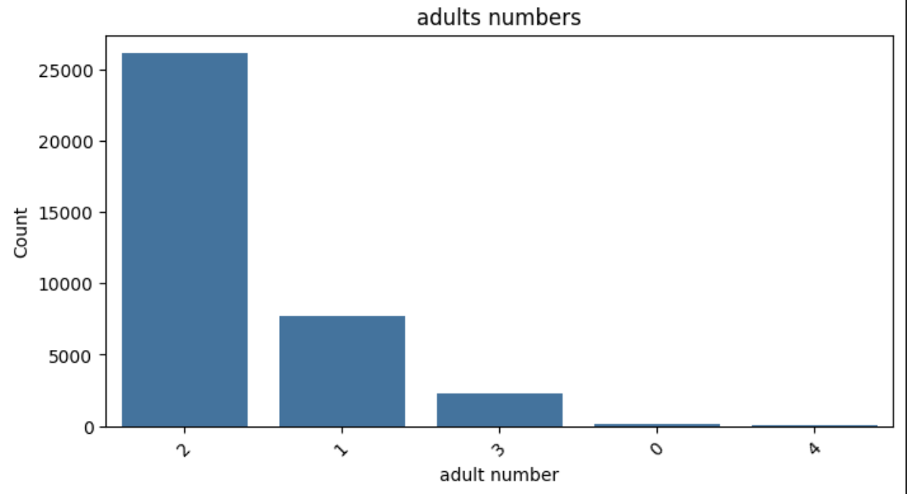
Number of Adult & Children request

Slide 8
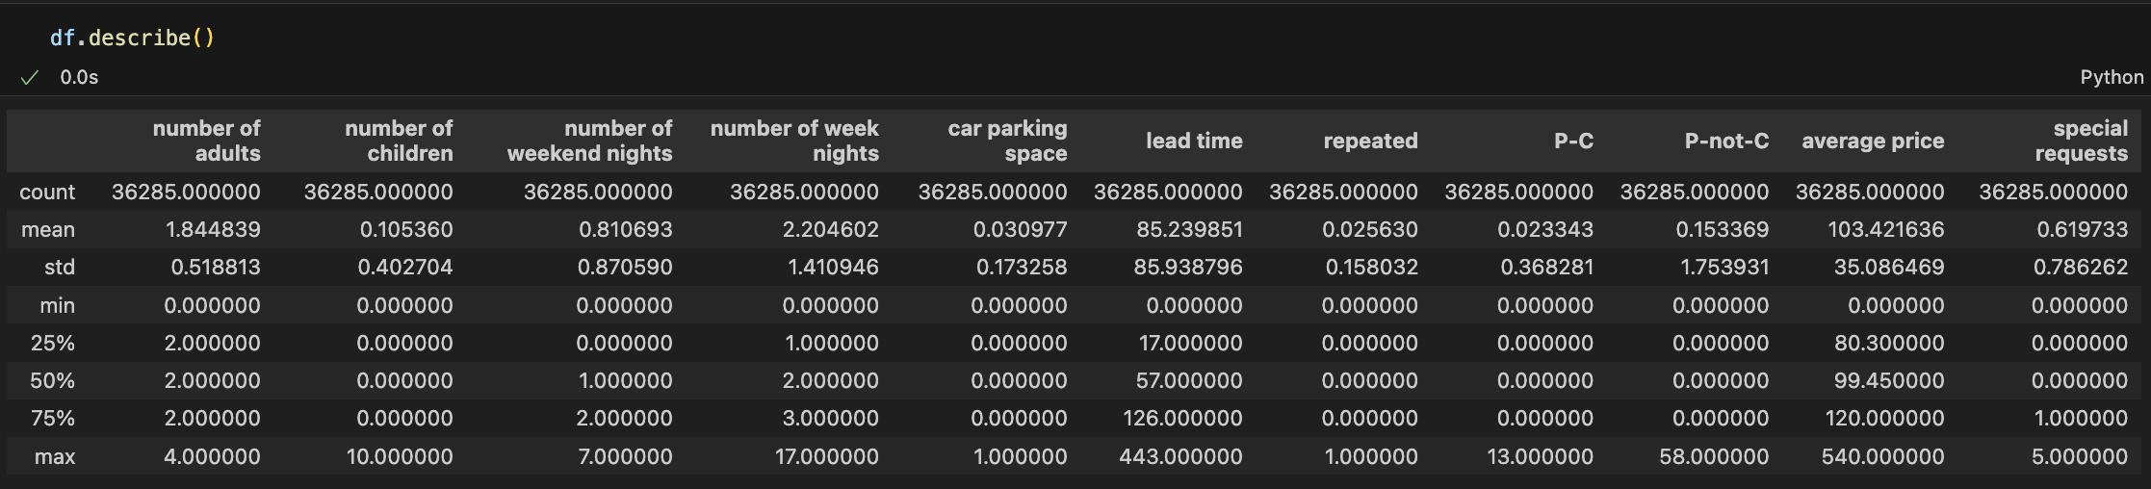
Summary Statistics of Numerical Columns

Slide 9
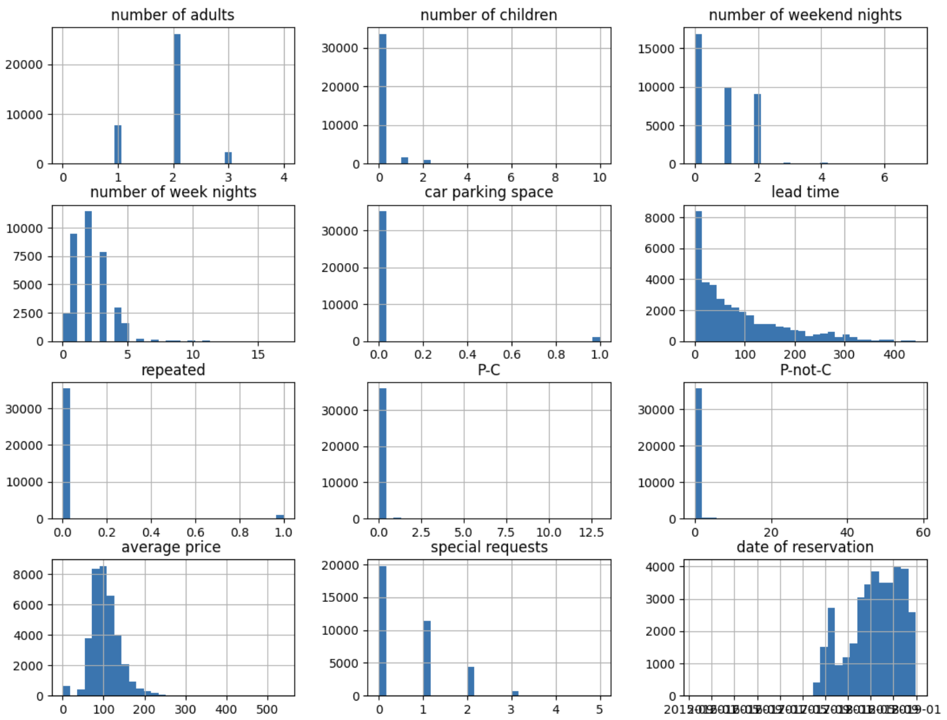
Distribution of Numerical Columns

Slide 10
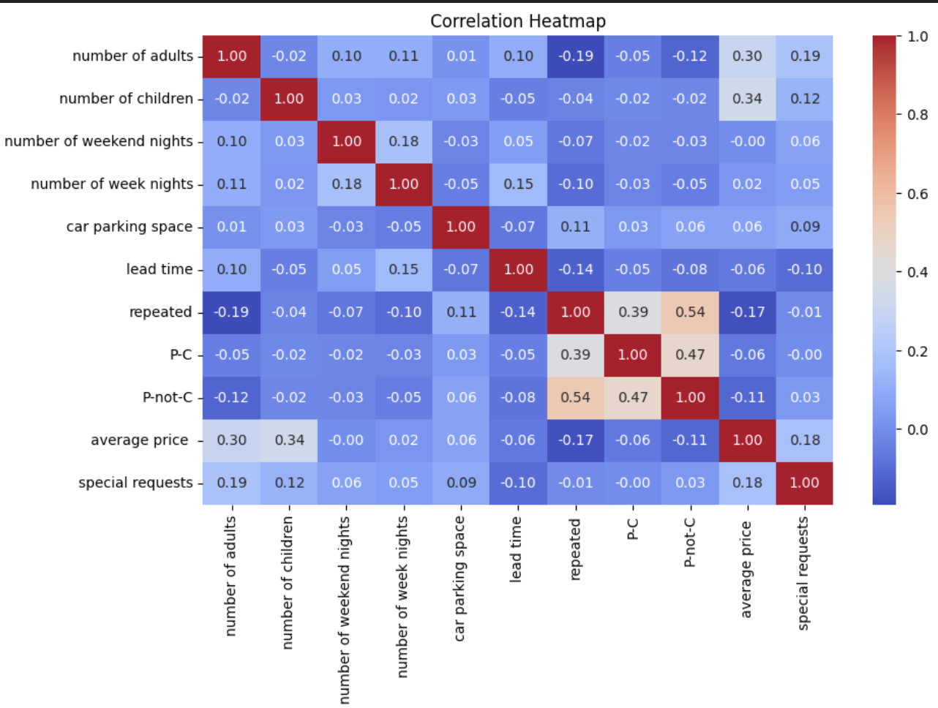
Correlation between Numerical Column

Slide 11
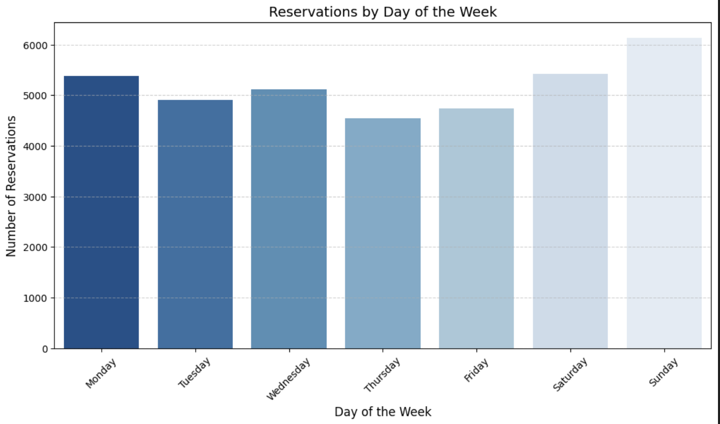
Highest Reservations by Day of Week

Slide 12
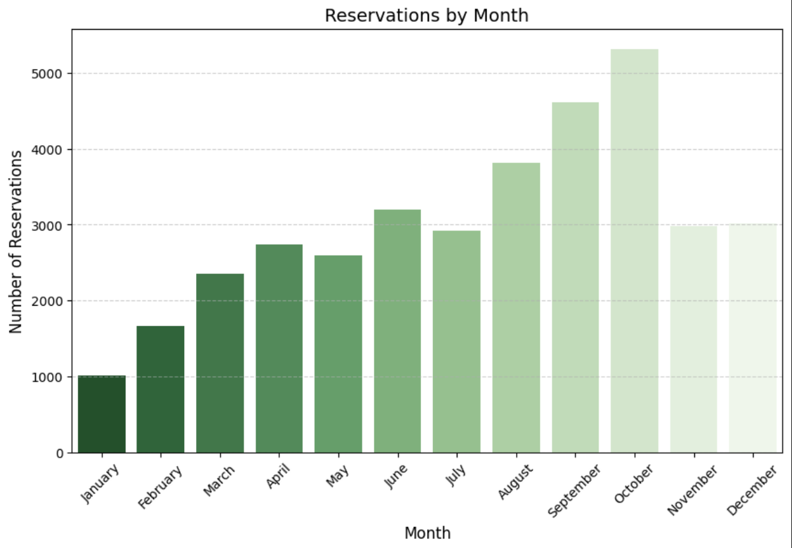
Highest Reservations by Month

Slide 13
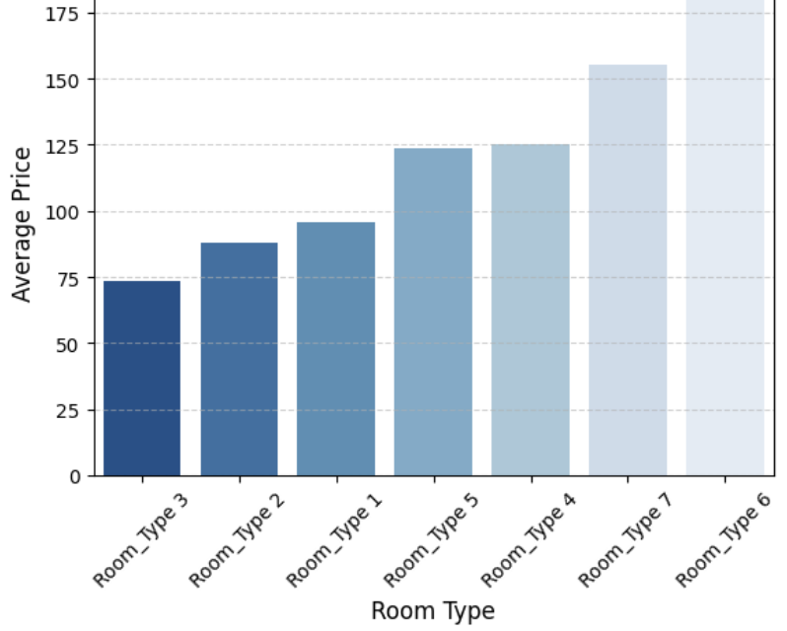
Average Price by Room Type

Slide 14
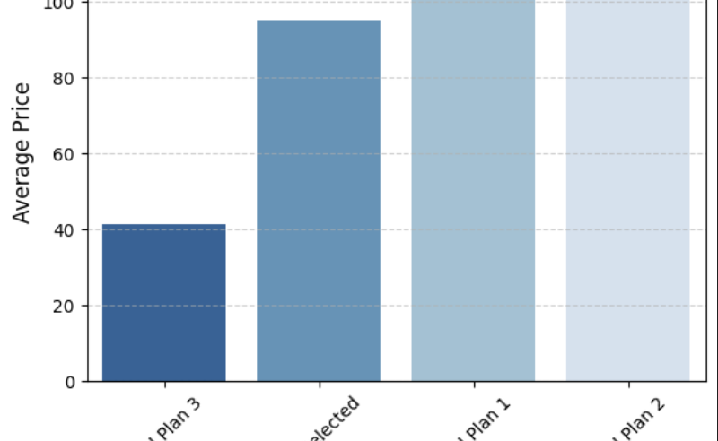
Average Price by Meal Type

Slide 15
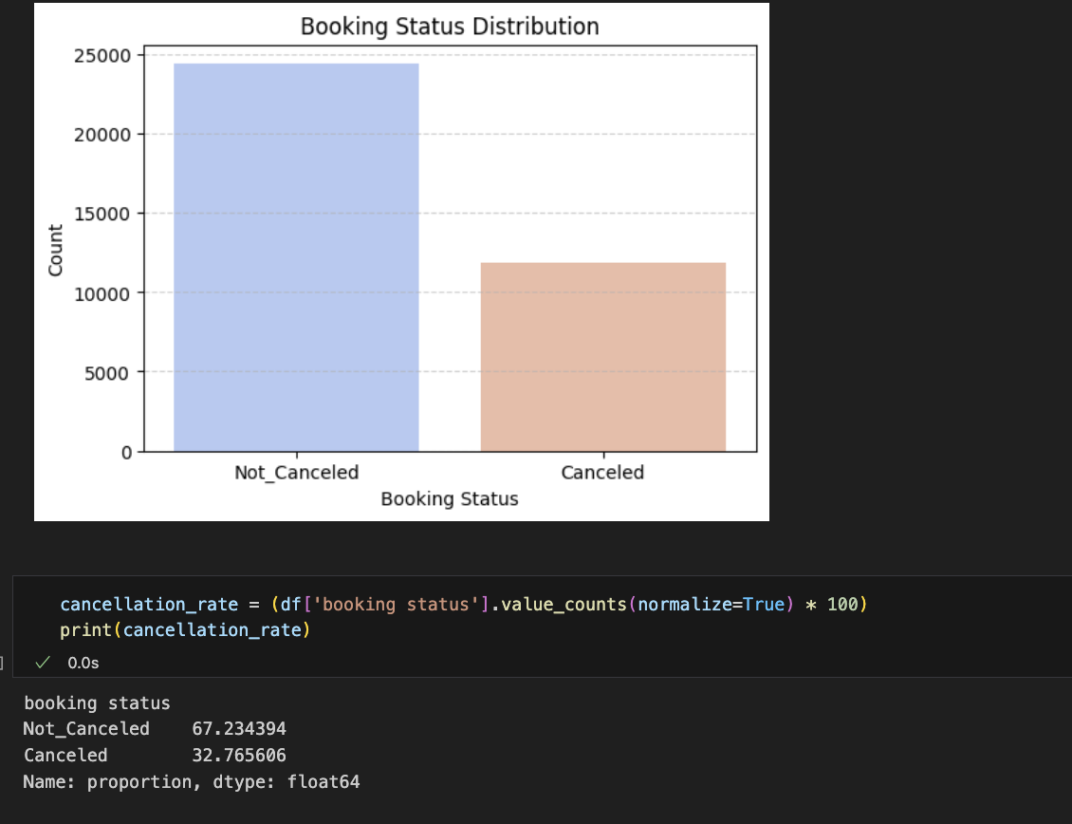
Canceled Bookings & Percentage

Slide 16
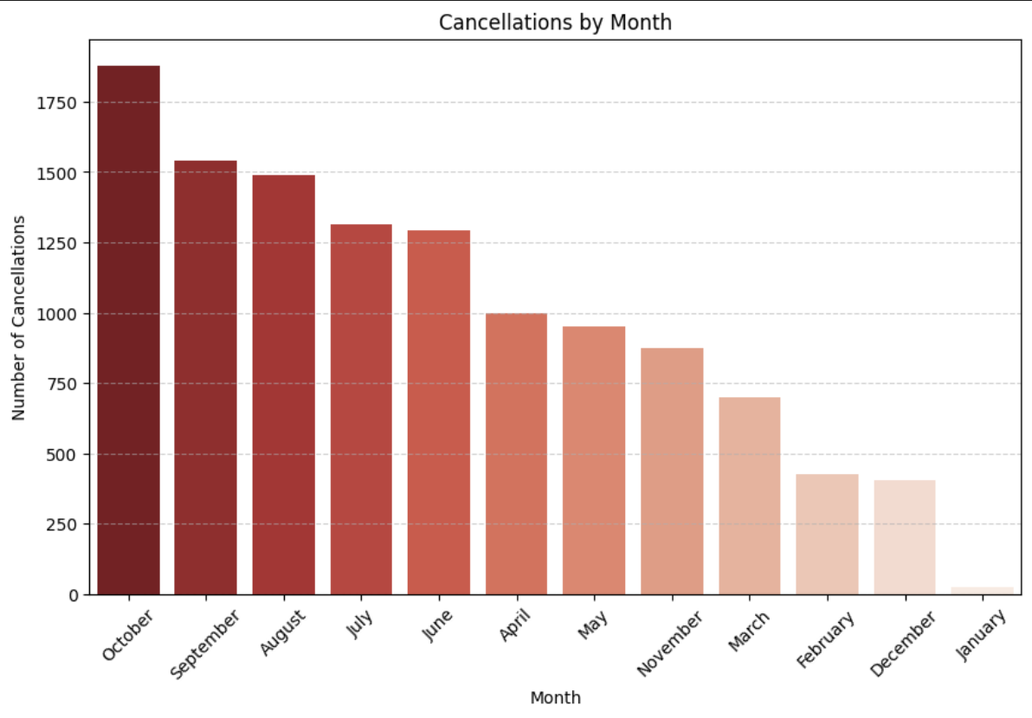
Highest Cancellations by Month

Slide 17
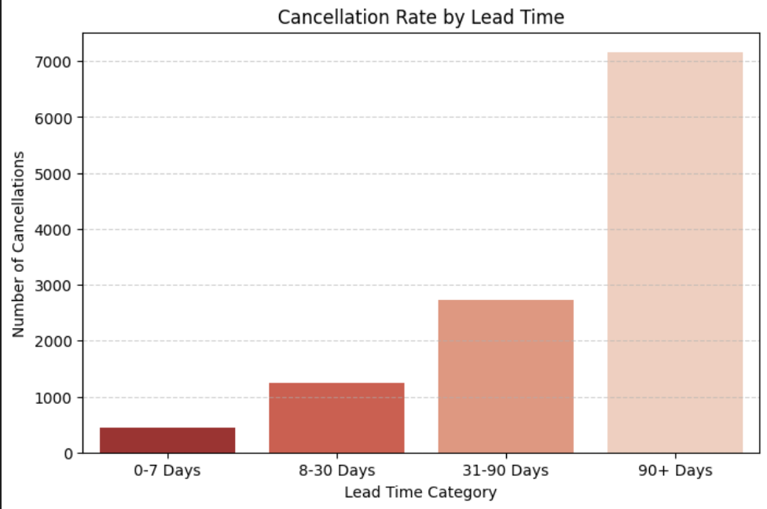
Last-minute Booking Cancellations

Slide 18
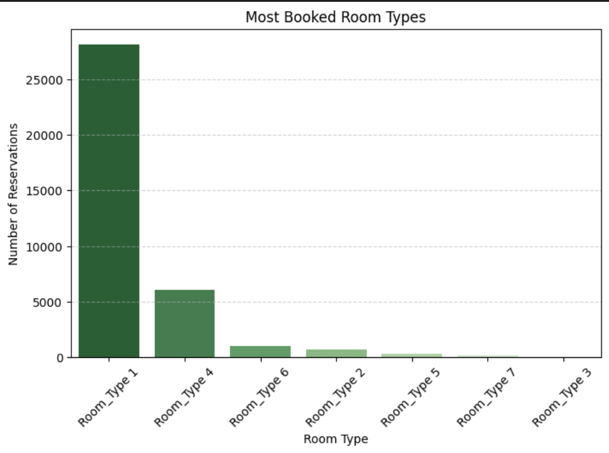
Most Booked Room Type

Slide 19
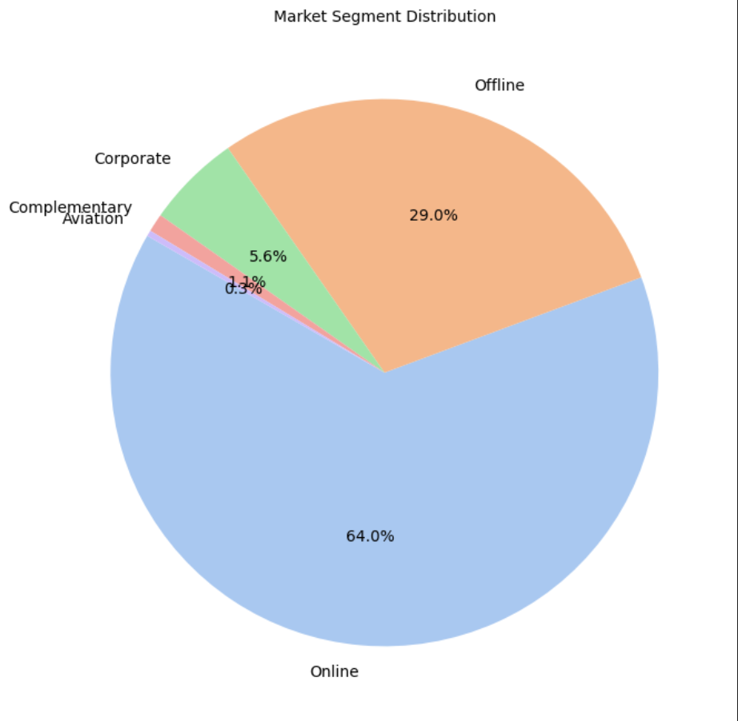
Most Common Market Segment

Slide 20
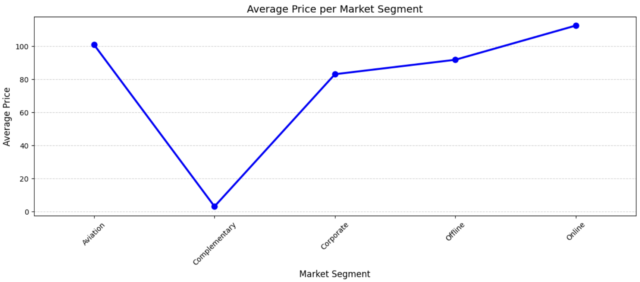
Pricing by Market Type

Slide 21
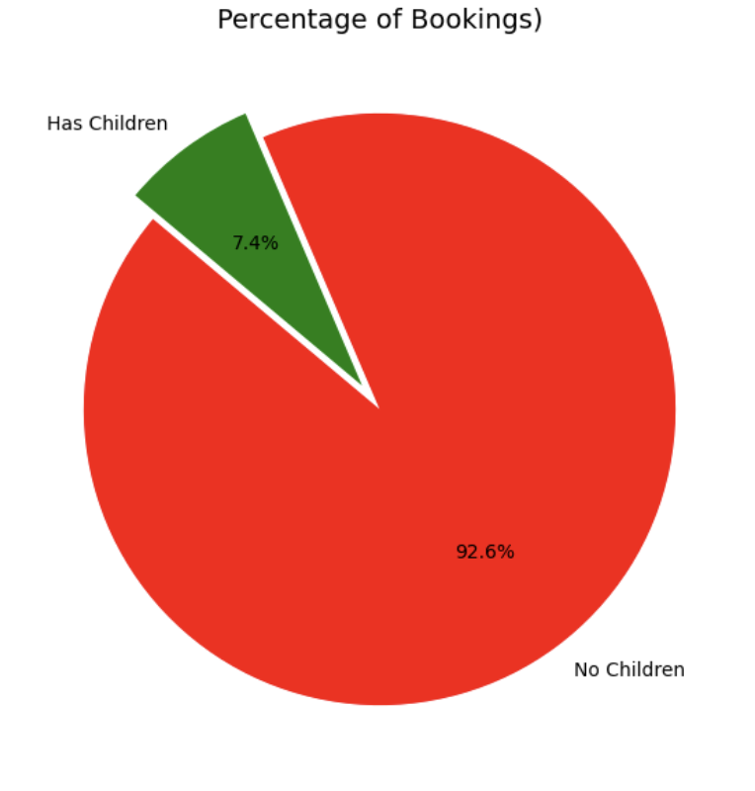
booking for family vs not family

Slide 22
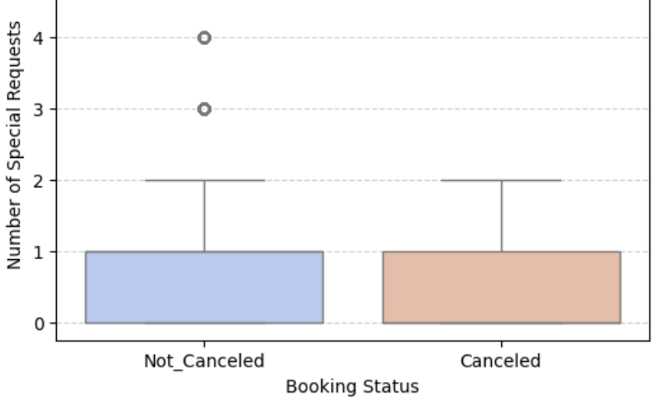
Impact of Special Requests on Cancellations

Slide 23
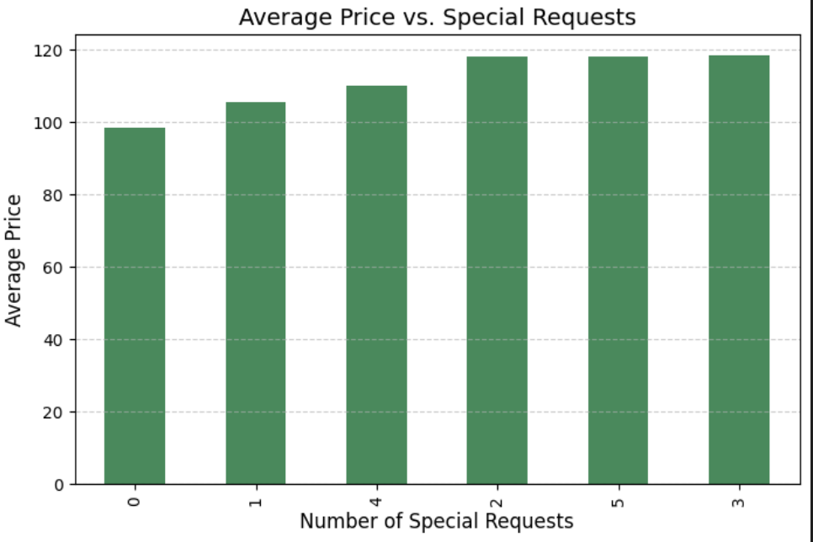
Average Price by Special Requests

Slide 24
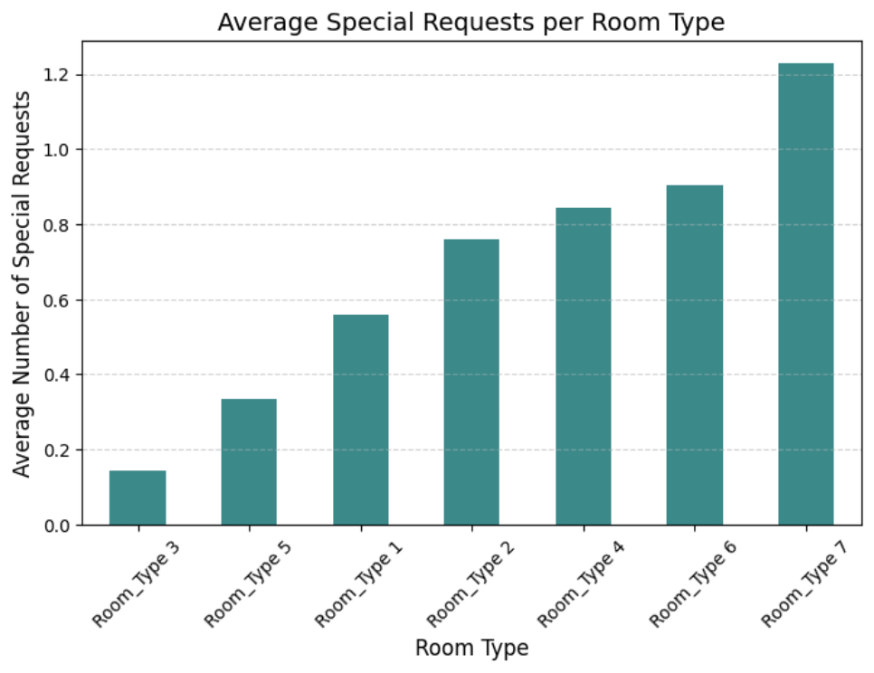
Room Type with Most Special Requests

Slide 25
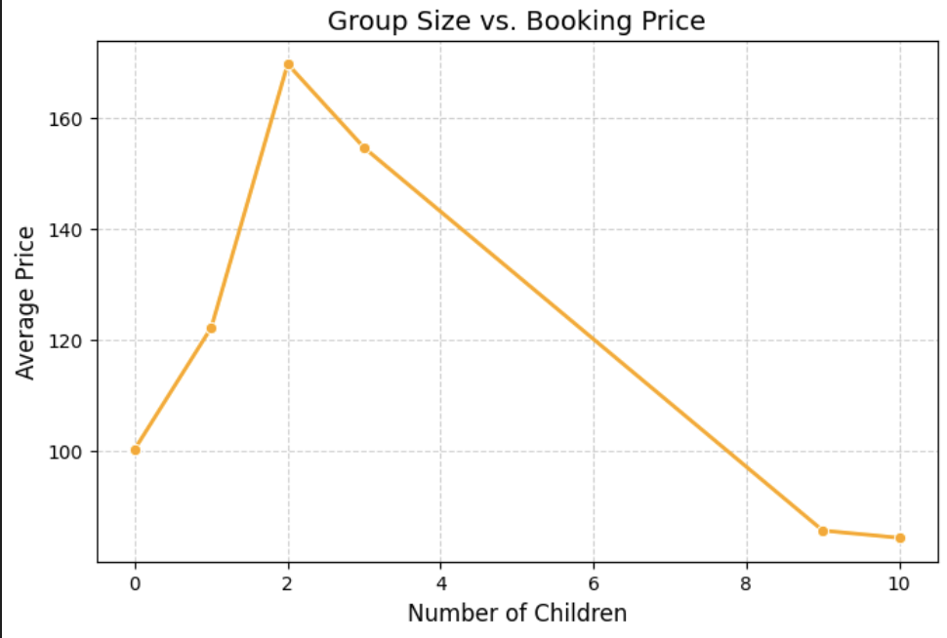
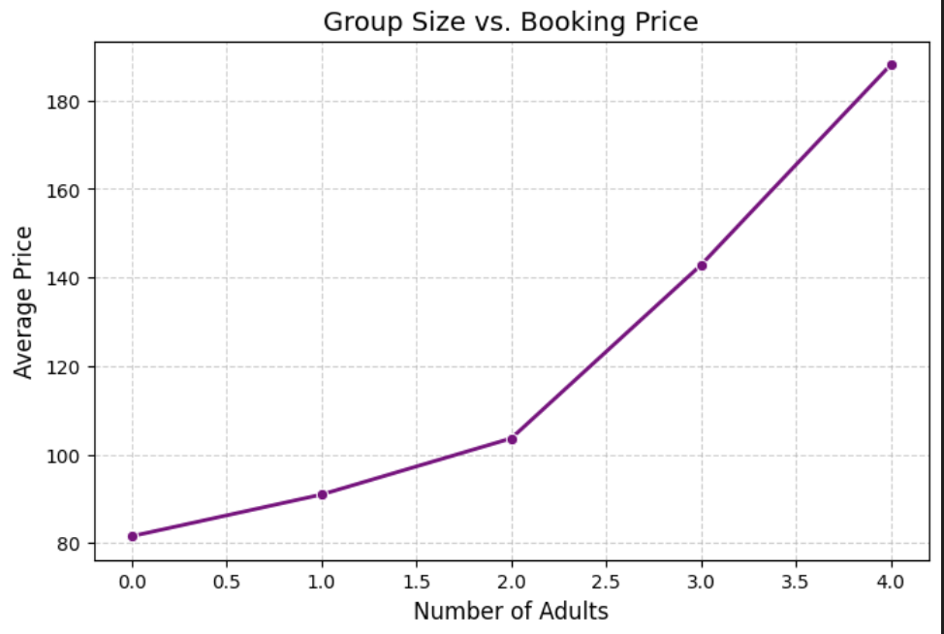
Family Impact on Booking Price

Slide 26
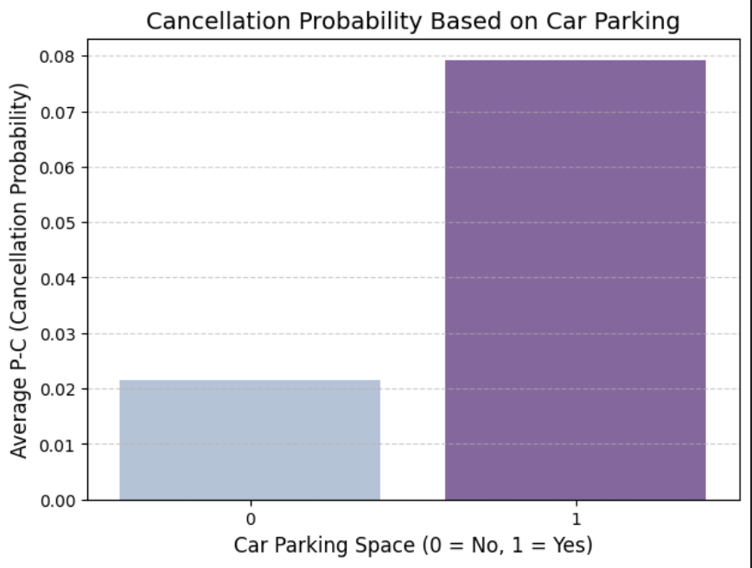
Car Parking & Cancellation Probability

Slide 27
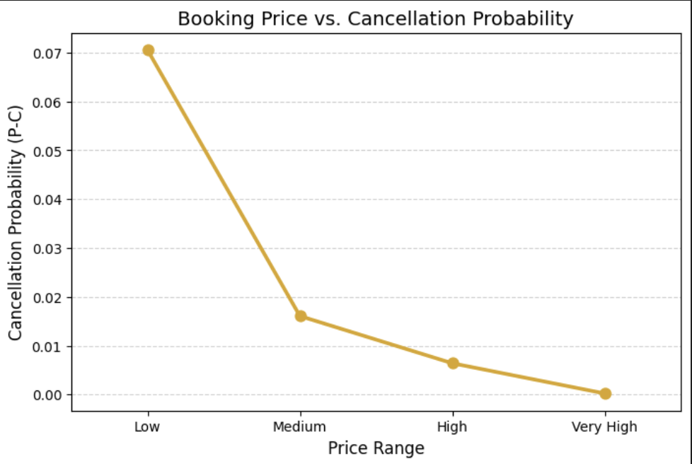
High Price & Cancellation Rate

Slide 28
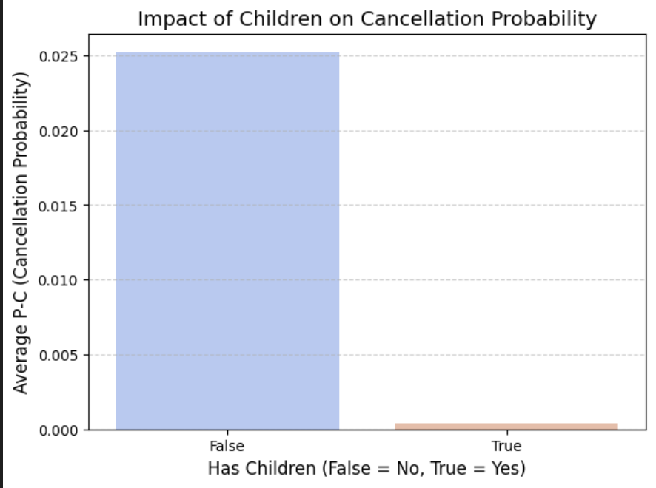
Children & Cancellation Probability

Slide 29
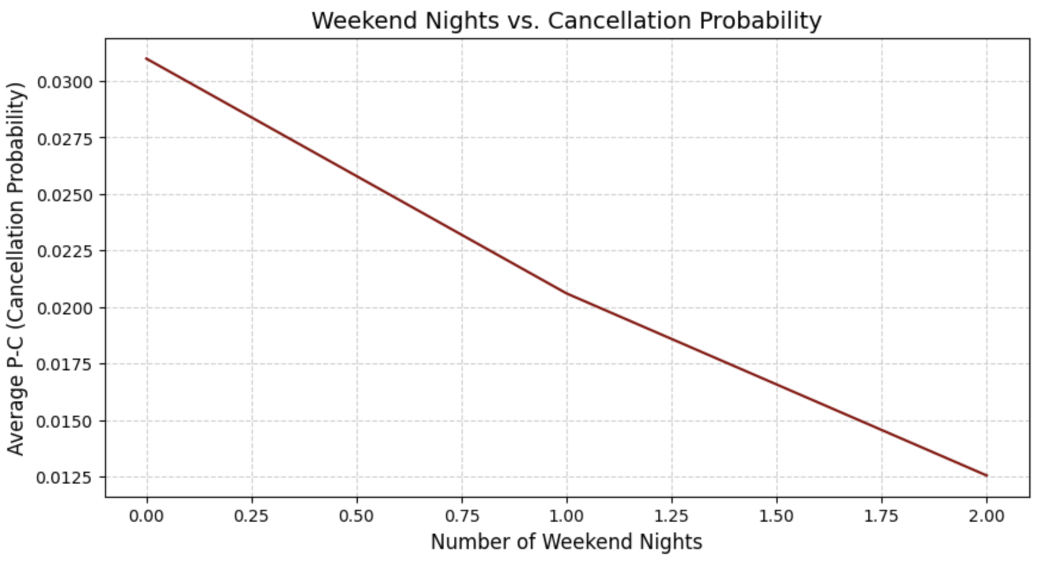
Weekend Nights & Cancellations

